Slide 1
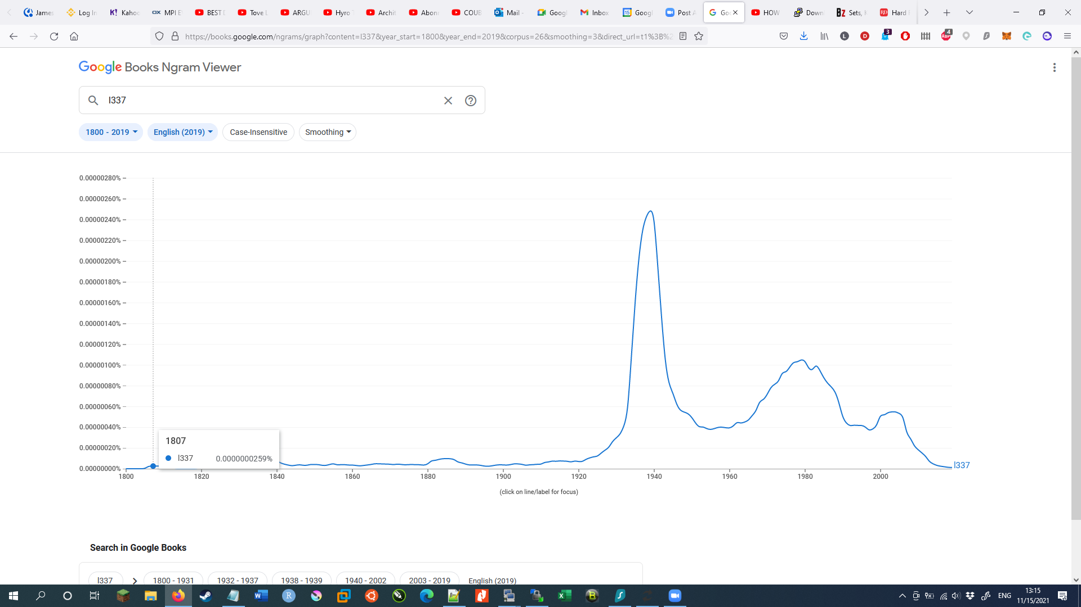
Elite (l337 = leet) coders tutorial 101

Slide 2


Goal of this session:
Getting y’all familiar with Linux
Give y’all a jump-off point to get into bioinfo
Hopefully get you excited to do data analysis
Prevent y’all from destroying the cluster
and asking me to fix it :P

Slide 3




Before this session
During this session
After we’re done

Slide 4

What we need
VPN
PuTTY / Kitty (ssh software)
What we’ll hopefully get out of this first (2nd) session
Basic file handling
Understanding on how to manipulate files
Learn how to NOT delete the entire cluster :P

Slide 5
Prior lesson:
mkdir # make a directory
Getting basic meta information from files
ls # list files/folders
ls -lh # Show all the metadata of files such as size and read/write/execute permissions
ln # make a link to file/folder
pwd # Path to Working Directory
basename # Gives the absolute file name. without directory
dirname # Gives the absolute directory name for file, without filename
readlink –e # full pathname
cd # change directory
If stuck, ask 4 help!
-h / --help # almost all tools come with a help list that shows the available commands and how to use them
mkdir --help
ls --help
sed –help
etc…

Slide 6
File lookup and assessments:
find # find a file in a location or multiple locations
touch # this creates an empty file, will have it's uses later
nano # a file editor, can be used to quickly edit files
less # a on-the-fly way of showing the content of a file
echo # Can be used to put text to STDout
Destructive file commands
cp # copy files, directories need to be done recursive
mv # move files or change it's name, directories need to be done recursively
rm # remove a file, directories need to be done recursively

Slide 7
File manipulations:
cat # concatenate files, can also be used to put file content onto STDout
zcat # the zipped equivalent of cat
head # take the top lines from a file
tail # take the bottom lines from a file
cut # you can split lines in sections, good for column extractions
split # break up a file into sub files
| # a pipe, this will put the STDout from the first command into the STDin
for the next command
Character lookups and replacements
grep # search for a work/character/regex in a file
grep 'string_search' file.txt
sed # replace one or all word/character/regex in a file
sed 's/string_search/string_replace/g' file.txt

Slide 8
Storing data into files:
> # directing output to a location
>> # adding an output to a location
1> # STDout
2> # STDerr
&> # STDout + STDerr (all output)

Slide 10
https://play.kahoot.it/

Slide 11

What’s next?
Next session
Understanding your environment
Working with Qsub
Bash
Getting familiar with GitHub and Conda
Local installation of tools
Session after:
EAGER2
HOPS
Whatever you want me to discuss
Additionally:
Basic bioinformatic principles (alignments, mapping, software's, R, etc)

